Slide 1
”DIKSHA” Sundaram Fin.Tech 2025
Journey Presentation –week 6
Anil Rasa
Date : 23-MAR-2025

Slide 2

Topics Covered in Fifth Week !

Slide 3
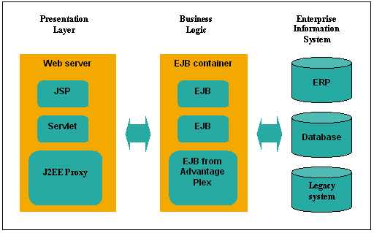
Learning 1 | My takeaways
→JEE
→CGI
→J2EE
→JSP

Slide 4
JEE:Java EE (now Jakarta EE), formerly Java 2 Platform, Enterprise Edition (J2EE), is a platform for building enterprise-level applications, providing a set of APIs, protocols, and services for distributed, scalable, and transactional systems.
CGI:The Common Gateway Interface (CGI) is a standard that facilitates communication between web servers and external databases or information sources. It acts as middleware, allowing web servers to interact with applications that process data and send back responses.
J2EE:
J2EE (Java 2 Platform, Enterprise Edition), now known as Jakarta EE, is a set of specifications and APIs that extend the Java SE platform for building enterprise-level, multi-tiered applications, including web services and distributed computing.
JSP:
JSP (JavaServer Pages) is a technology that allows developers to create dynamic web content using Java, offering a more flexible and readable way to embed Java logic within HTML pages, extending the functionality of Servlets.
Q

Slide 5
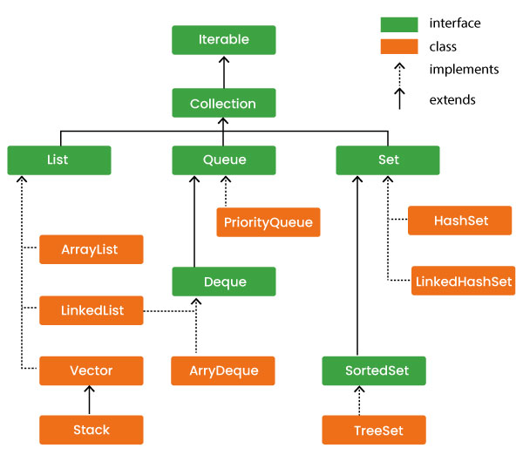
Learning 2| My Takeaways
→ Exceptions
→ Collection Framework
→ Generics
→Java8
→Lambda

Slide 6
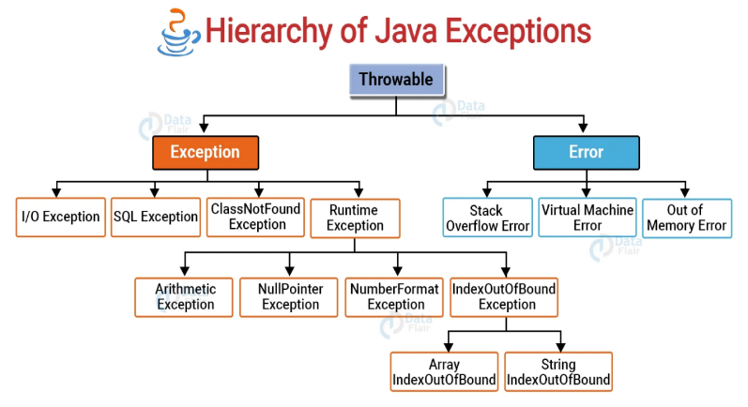
Exceptions:Abnormal termination of the Execution of a program is called Abstraction.
How to Handle Exceptions:
->Try()
->Catch()
->Throw()
->Throws()
->Finally()
Syntax:
try: public class ExceptionExample {
public static void main(String[] args) {
try {
int result = 10 / 0;
} catch (ArithmeticException e) {
System.out.println("Cannot divide by zero!");
} finally {
System.out.println("Execution completed.");
}
}
}

Slide 7
Types of Exceptions:
Built-in exceptions 2)User-Defined Exceptions
1)Built-in exceptions:
Built-in exceptions are the exceptions that are available in Java libraries. These exceptions are suitable to explain certain error situations. Below is the list of important built-in exceptions in Java.
→ArithmeticException
→ArrayIndexOutOfBoundsException
→FileNotFoundException
2)User-Defined Exceptions
Sometimes, the built-in exceptions in Java are not able to describe a certain situation. In such cases, the user can also create exceptions which are called ‘user-defined Exceptions’.
Collection Framework():
The Java collections framework is a set of classes and interfaces that implement commonly reusable collection data structures.
→A collection is a group of objects that are organized according to a scheme.
Types of collections :1)Linear 2) Hierarchical 3) Graphs
Generics: Generics are used to restrict the list to hold objects only one type.
Syntax:Pair<Integer, String> p1 = new Pair<>(1, "apple");

Slide 8
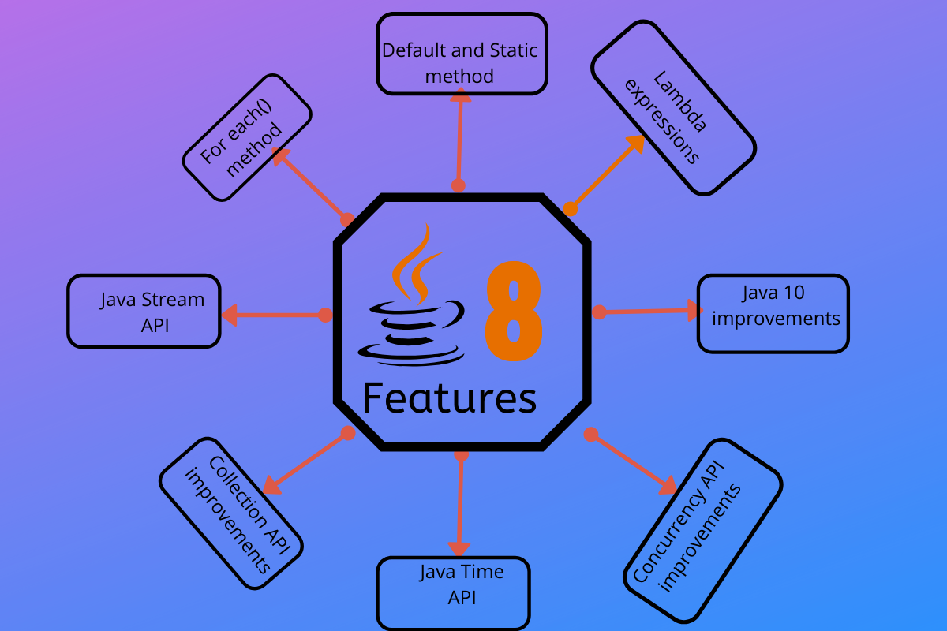
Learning 3| My takeaways
→Comparator and Comparable
→Hash Map
→ Java 8
→Optional class
→Lambda

Slide 9
Comparator and Comaprable:
Comparable: It is used to define the natural ordering of the objects within the class.
Comparator: It is used to define custom sorting logic externally.
HashMap():
In Java, HashMap is part of the Java Collections Framework and is found in the java.util package. It provides the basic implementation of the Map interface in Java. HashMap stores data in (key, value) pairs. Each key is associated with a value, and you can access the value by using the corresponding key.
Java-8 Features:
Java 8 introduced powerful features like lambda expressions, the Stream API, the Optional class, improved Date/Time API, and support for functional programming, significantly enhancing code conciseness and expressiveness.
Optional class:This classes helps handle potential null values ,Preventing null pointer exceptions with a more functional approach.
Lambda Expressions:
These are short, concise ways to define anonymous functions, making code more readable and suitable for functional programming paradigms.
Ex:
public class LambdaExample {
public static void main(String[] args) {
MyFunctionalInterface greeting = () -> System.out.println("Hello, Lambda!");
greeting.sayHello();
}
}

Slide 10
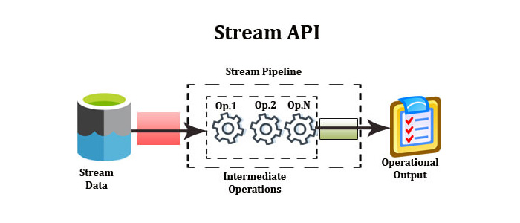
Learning 4 | takeaways
→Method References
→Stream API
→Java 9
→ Java 11
→JDBC

Slide 11
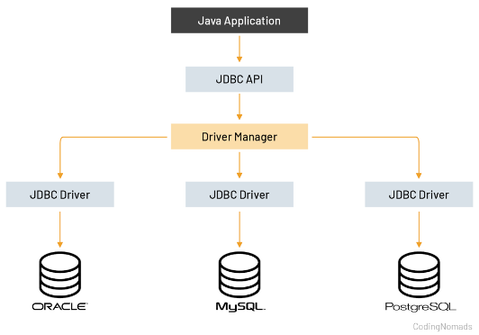
Method Reference:
Method references, introduced in Java 8, are a concise shorthand for referring to methods or constructors. Think of them as a way to say, "Hey Java, use this method here!" without writing out the entire method call. They work hand-in-hand with lambda expressions to bring a touch of functional programming to Java.
Stream API:
Stream API is used to process collections of objects. A stream in Java is a sequence of objects that supports various methods that can be pipelined to produce the desired result.
There are two types of Operations in Streams:
→Intermediate Operations:
→Terminal Operations:
Java 11:
Java 11 introduced significant features like the Epsilon garbage collector, a new HTTP client, local variable syntax for lambda parameters, and the Java Flight Recorder (JFR), along with improvements to string methods and enhancements for AArch64 processors.
JDBC:
The JDBC API supports both two-tier and three-tier processing models for database
access. Figure 1: Two-tier Architecture for Data Access. In the two-tier model, a Java
applet or application talks directly to the data source.
Key interfaces include Driver, ResultSet, RowSet, PreparedStatement, and
Connection. Important classes include DriverManager, Types, Blob, and Clob.
DriverManager: It plays an important role in the JDBC architecture.

Slide 12
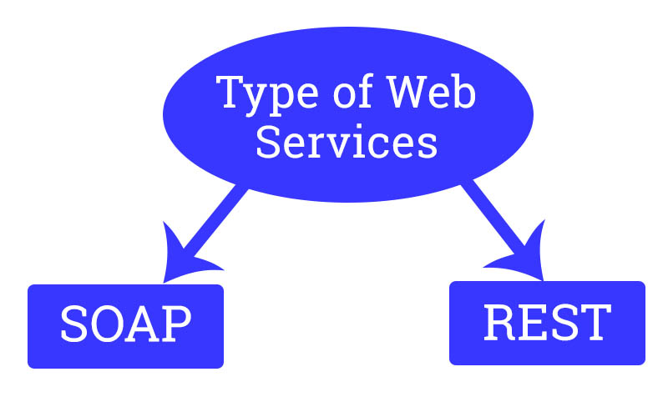
Learning 5 | takeaways
→Callabale Statements
→Web services
→Restfull API
→HTTP Status Codes
→GraphQl

Slide 13
Callable Statements:
The CallableStatement interface allows the use of SQL statements to call stored procedures.
Callable is a statement it is extends to prepared statements. To execute callable statements we use callable statement.
→They are, Statement – Used to execute normal SQL queries. PreparedStatement – Used to execute dynamic or parameterized SQL queries. CallableStatement – Used to execute the stored procedures.
Web Services:
→Web services are the application or business logic that is provided to interact with the operational server.
→The two main types of web services are Simple Object Access Protocol (SOAP) and Representational State Transfer (REST).
1)SOAP:
SOAP (Simple Object Access Protocol) web services are a way to exchange structured data between web services using XML. SOAP is an industry standard that's part of service-oriented architecture (SOA).
2)RESTful web service
A RESTful web service is a type of web service that follows the principles of Representational State Transfer (REST), a software architectural style, to facilitate communication between clients and servers over the internet, typically using HTTP.
States of REST-Architecture:
→REST (Representational State Transfer) architecture is characterized by six key properties:
client-server, stateless, cacheable, uniform interface, layered system, and optional code-on-demand, which, when applied, lead to a system that is scalable, simple, and reliable.

Slide 14
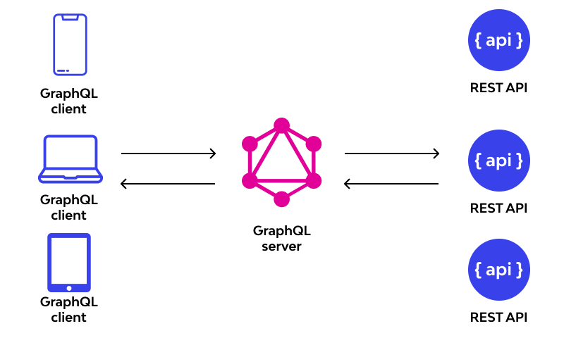
HTTP Status Codes:
All HTTP response status codes are separated into five classes or categories. The first digit of the status code defines the class of response, while the last two digits do not have any classifying or categorization role. There are five classes defined by the standard
→1xx informational response – the request was received, continuing process.
→2xx successful – the request was successfully received, understood, and accepted.
→3xx redirection – further action needs to be taken in order to complete the request.
→4xx client error – the request contains bad syntax or cannot be fulfilled.
→5xx server error – the server failed to fulfil an apparently valid request.
GraphQL:
GraphQL is a query language and server-side runtime for
application programming interfaces (APIs) that gives API
clients exactly the data they requested. As an alternative to
REST, GraphQL allows developers to make requests to fetch
data from multiple data sources with a single API call.
→There are three types of GraphQL operations: queries,
mutations and subscriptions. A query reads data, a mutation
changes data and a subscription listens for live, streaming
data.

Slide 15
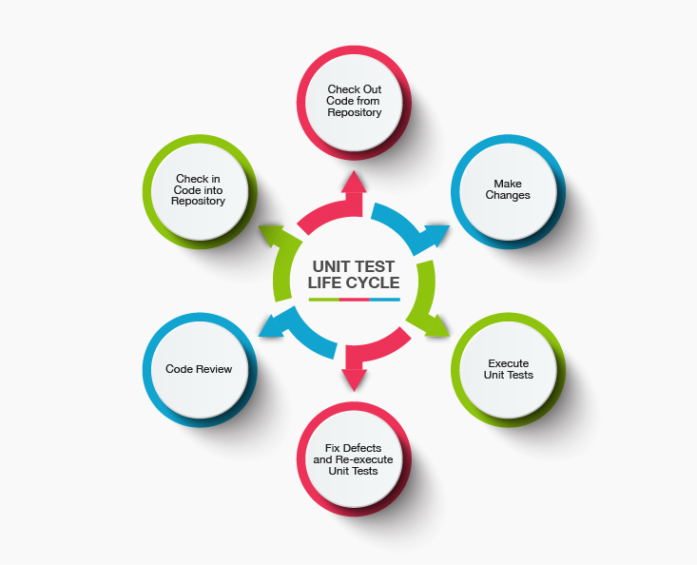
Learning 6 | takeaways
→GraphQL
→Unit Testing
→Junit

Slide 16
GraphQL:GraphQL is a query language for APIs and a runtime for executing those queries by using a type system you define for your data. It was developed by Facebook in 2012 and open-sourced in 2015. Unlike REST, which requires multiple endpoints for different resources, GraphQL allows clients to request exactly the data they need in a single query.
Key Features of GraphQL: Flexible Queries: Clients can specify the exact fields they need.
Single Endpoint: Unlike REST, which often has multiple endpoints, GraphQL typically has a single endpoint for all queries.
What Is Unit-Testing:
Unit testing is a software testing method where individual components (or "units") of a program are tested in isolation to verify that they work correctly. The goal is to ensure that each function or method behaves as expected, independent of external dependencies.
What is Junit:
JUnit is a unit testing framework for Java that allows developers to write and run automated tests to verify their code's correctness. It follows a test-driven development (TDD) approach and is widely used in Java projects.
→It consist of
JUnit Platform-Unit means a popular, free, and open-source framework used for writing and running automated unit tests in Java
JUnit Jupiter-Unit Jupiter is the combination of the programming model and extension model for writing tests and extensions in JUnit 5.
JUnit Vintage-JUnit Vintage test engine allows you to execute current tests based on JUnit 3 and JUnit 4 using the JUnit Platform infrastructure.

Slide 17
Thank You

